Slide 1
COMPUTER NETWORK

Slide 2
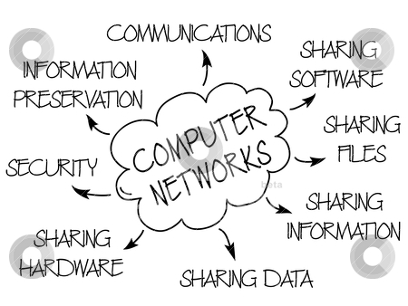
Uses of CN

Slide 3
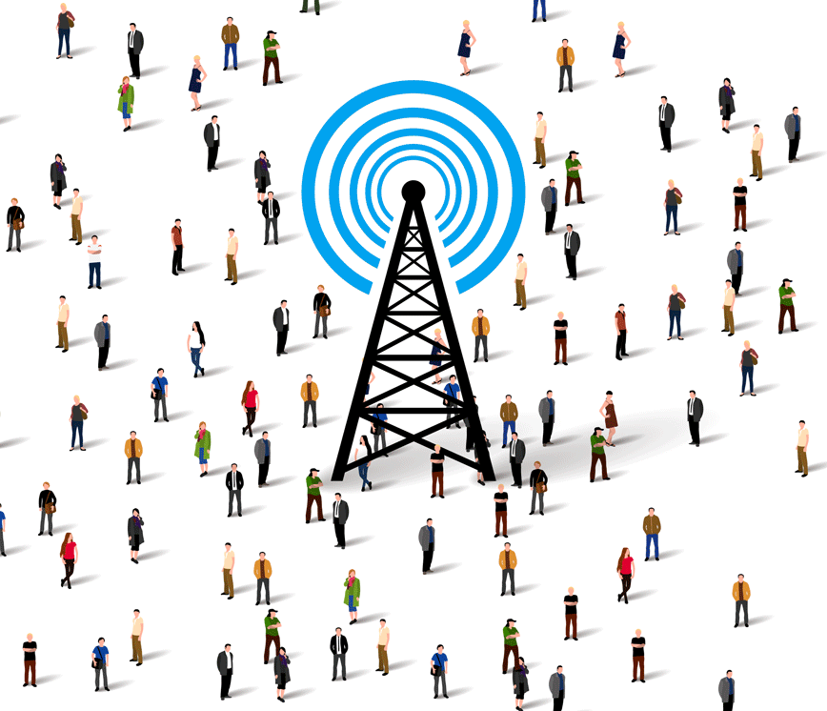
What is Network ?
◆ A network consists of two or more computers that are linked in order to share resources (such as printers and CDs), exchange files, or allow electronic communications.
◆ The computers on a network may be linked through cables, telephone lines, radio waves, satellites, or infrared light beams.

Slide 4
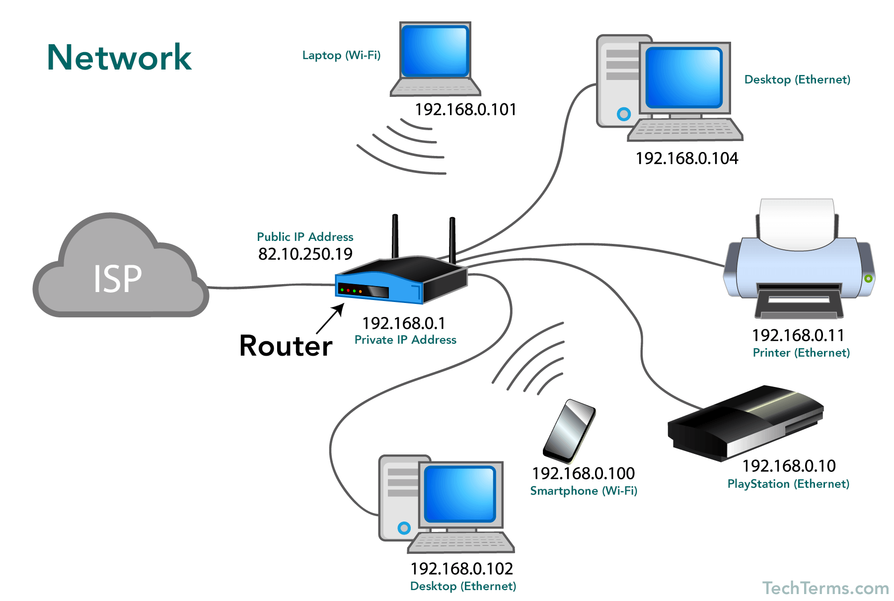

Slide 5
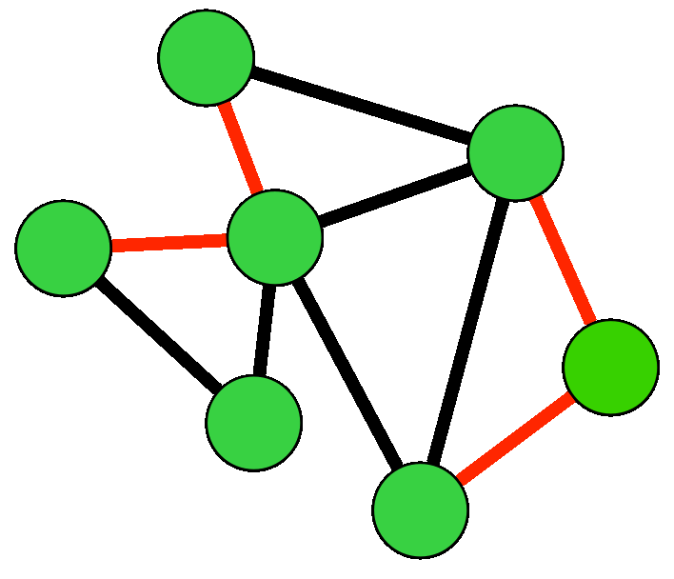
Basic Types of Networks
Local Area Network (LAN)
Personal Area Network (PAN)
Metropolitan Area Network (MAN)
Wide Area Network (WAN)
Campus Area Network (CAN)
Storage Area Network (SAN)

Slide 6
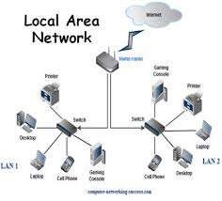
Local Area Network (LAN)
◆ A LAN is a network that is used for communicating among computer devices, usually within an office building or home. And it is private
◆ LAN’s enable the sharing of resources such as files or hardware devices that may be needed by multiple users • • Is limited in size, typically spanning a few hundred meters, and no more than a mile
◆ Is fast, with speeds from 10 Mbps to 10 Gbps
◆ Requires little wiring, typically a single cable connecting to each device
◆ Has lower cost compared to MAN’s or WAN’s
◆ LAN’s can be either wired or wireless. Twisted pair, coax or fibre optic cable can be used in wired LAN’s.

Slide 7
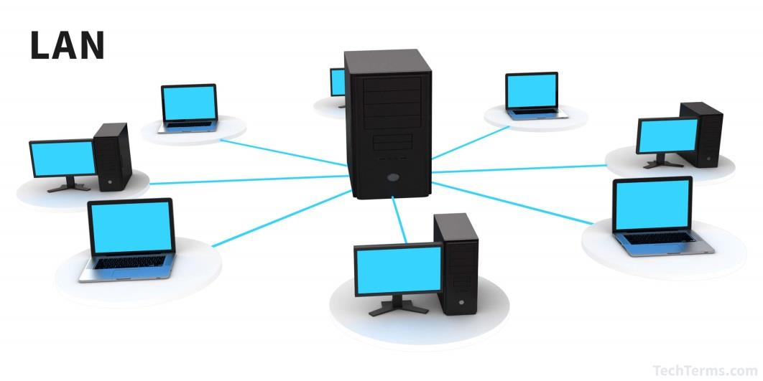
Advantages of LAN
◆ Speed
◆ Cost
◆ Security
◆ Resource Sharing ex – all computers are connected to single printer
This is client server model

Slide 8
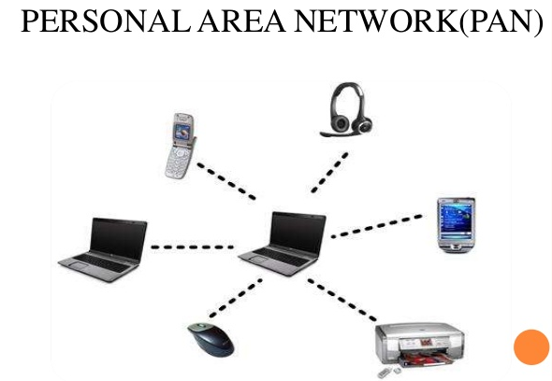
Personal Area Network (PAN)
◆ A PAN is a network that is used for communicating among computer devices, usually home.
◆ PAN’s enable the sharing of resources such as files or hardware devices that may be needed by multiple users • • Is limited in size, typically spanning a few hundred meters
◆ Is fast, with speeds from 10 Mbps to 10 Gbps
◆ Requires little wiring, typically a single cable connecting to each device
◆ Has lower cost compared to MAN’s or WAN’s
◆ LAN’s can be either wired or wireless. Twisted pair, coax or fibre optic cable can be used in wired LAN’s.

Slide 9
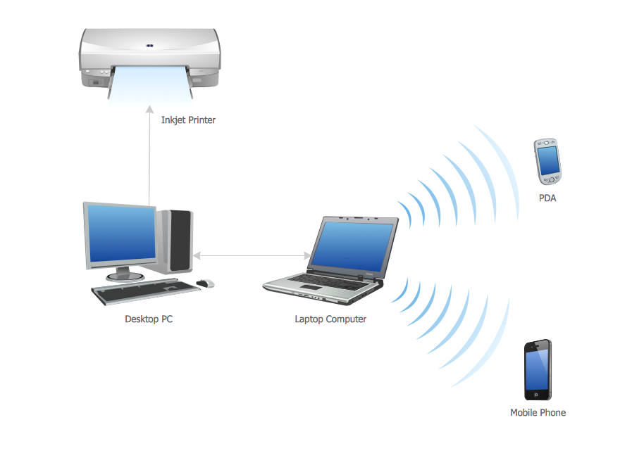
Advantages of PAN
◆ Speed
◆ Cost
◆ Security
◆ Resource Sharing

Slide 10
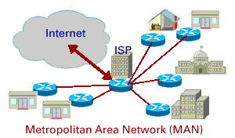
Metropolitan Area Network (MAN)
◆ A metropolitan area network (MAN) is a large computer network that usually spans a city or a large campus.
◆ A MAN is optimized for a larger geographical area than a LAN, ranging
from several blocks of buildings to entire cities.
◆ A MAN might be owned and operated by a single organization, but it usually will be used by many individuals and organizations.
◆ A MAN often acts as a high speed network to allow sharing of regional
resources.
◆ A MAN typically covers an area of between 5 and 50 km diameter.
◆ Examples of MAN: Telephone company network that provides a high
speed DSL to customers and cable TV network.

Slide 11
Advantages of MAN
◆ Speed
◆ Cost
◆ Security
◆ Resource Sharing

Slide 12
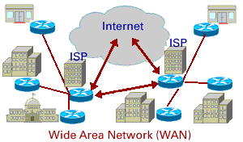
Wide Area Network (WAN)
◆ WAN covers a large geographic area such as country, continent or even whole of the world.
◆ A WAN is two or more LANs connected together. The LANs can
be many miles apart.
◆ To cover great distances, WANs may transmit data over leased high-speed phone lines or wireless links such as satellites.
◆ Multiple LANs can be connected together using devices such as bridges, routers, or gateways, which enable them to share data.
◆ The world's most popular WAN is the Internet.

Slide 13
Advantages of WAN
◆ Speed
◆ Cost
◆ Security
◆ Resource Sharing

Slide 14
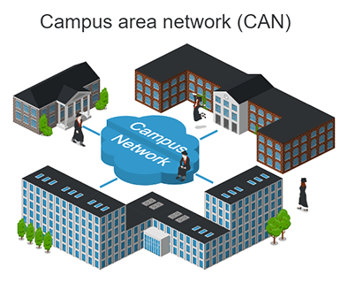
Campus Area Network (CAN)
A campus area network (CAN) is a network of multiple interconnected local area networks (LAN) in a limited geographical area. A CAN is smaller than a wide area network (WAN) or metropolitan area network (MAN).
A CAN is also known as a corporate area network (CAN).
CAN benefits are as follows:
Cost-effective
Wireless, versus cable
Multidepartmental network access

Slide 15
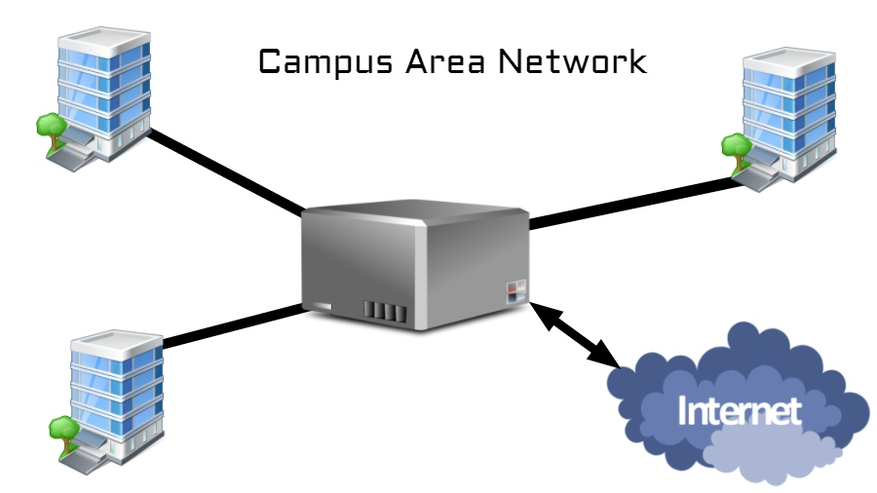
Advantages of CAN
Speed
Reliability
Campus Interconnection
Better for Every Consumer

Slide 16
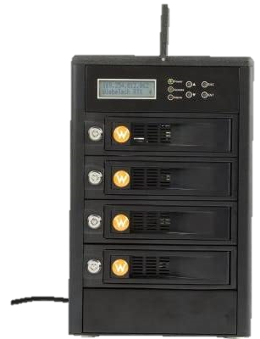
Storage Area Network (SAN)
A Storage Area Network (SAN) is a specialized, high-speed network that provides block-level network access to storage. SANs are typically composed of hosts, switches, storage elements, and storage devices that are interconnected using a variety of technologies, topologies, and protocols.
This enables each server to access shared storage as if it were a drive directly attached to the server. When a host wants to access a storage device on the SAN, it sends out a block-based access request for the storage device.

Slide 17
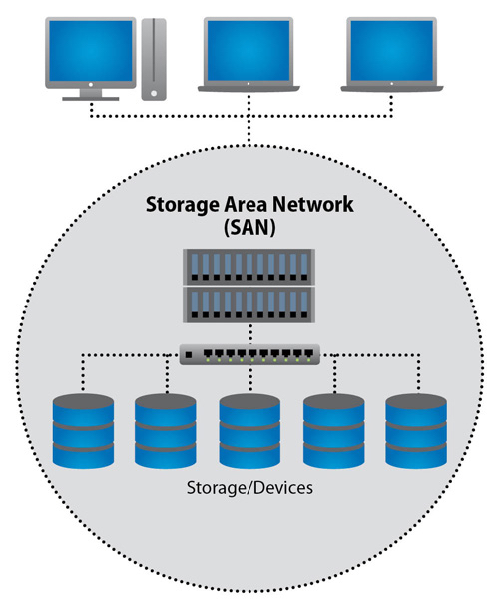
Advantages of SAN
Low Expense
fault tolerance
Disk Mirroring
Real Time Update
Aminstrator Control
Ex – YouTube(all can see a videos uploaded by others)

Slide 18
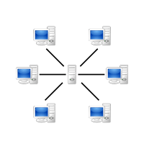
Peer to Peer Model
All computers are connected with a switch or direct cables and there is no restriction bw two or more computers to access information, Independent
Ex- BitTorent, Bitcoin, Zoom

Slide 19

Client-Server Model
It has admin, has restriction or rules, Server is leader, Dependent
Ex- LAN, DNS, Adult websites …

Slide 20
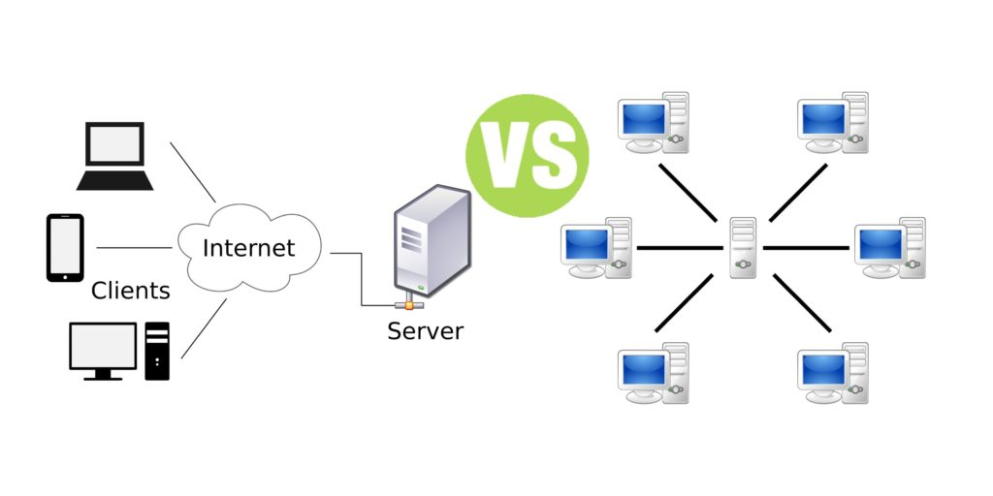

Slide 21
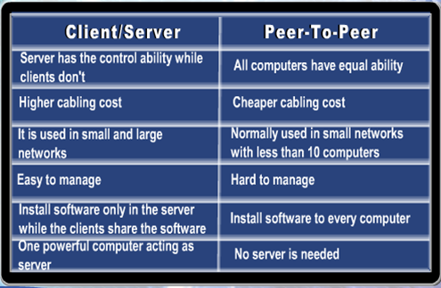

Slide 22
OSI MODEL

Slide 23
INTRODUCTION
Open systems interconnection basic reference model (OSI reference model or OSI model) is an abstract description for layered communications and computer network protocol design. It was developed as part of the open systems interconnection (OSI) initiative. In its most basic form, it divides network architecture into seven layers which, from top to bottom, are the application, presentation, session, transport, network, data-link, and physical layers. It is therefore often referred to as the OSI seven layer model.

Slide 24
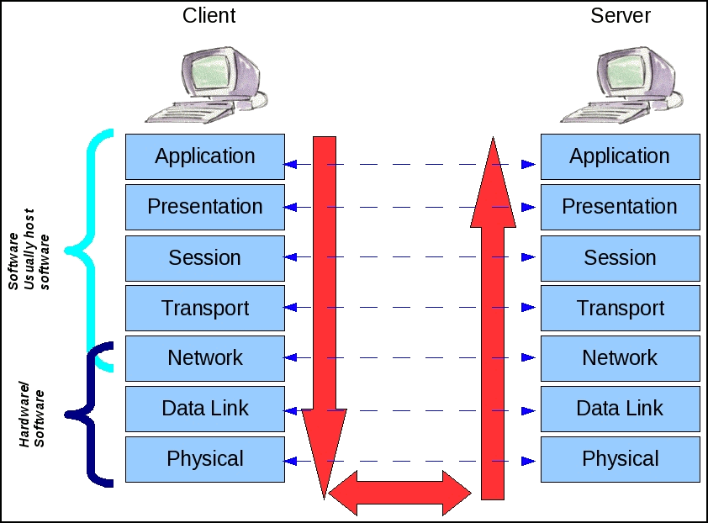
OSI MODEL

Slide 25
OSI Model's 7 Layers
APPLICATION
Application to Application
APPLICATION
PRESENTATION
Application to Application
PRESENTATION
SESSION
Application to Application
SESSION
TRANSPORT
Process to Process
TRANSPORT
NETWORK
Source to Destination
NETWORK
Router
Source to Destination
DATA LINK
Hop to Hop
Switch
DATA LINK
Hop to Hop
Hub and Repeater
PHYSICAL
PHYSICAL
Physical Medium

Slide 26
Data, Protocol & Activities
OSI Layers
TCP/IP Suit
Activities
Application
Application
Telnet, FTP, SMTP, HTTP, DNS, SNMP, Specific address etc…
To allow access to network resources
Presentation
Presentation
To Translate, encrypt, and compress data, packets
Session
Session
To establish, manage, and terminate session
Transport
Transport
SCTP, TCP, UDP, Sockets and Ports address
To Provide reliable process-to-process Message delivery and error recovery
Network
Network
IP, ARP/RARP, ICMP, IGMP, Logical address
To move packets from source to destination; to provide internetworking
Data Link
Data Link
IEEE 802 Standards, TR, FDDI, PPP, Physical address
To organize bits into frames; to provide Hop-to-hop delivery
Physical
Physical
Medium, Coax, Fiber, 10base, Wireless
To Transmit bits over a medium; to provide Mechanical and electrical specifications

Slide 27
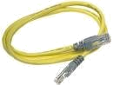
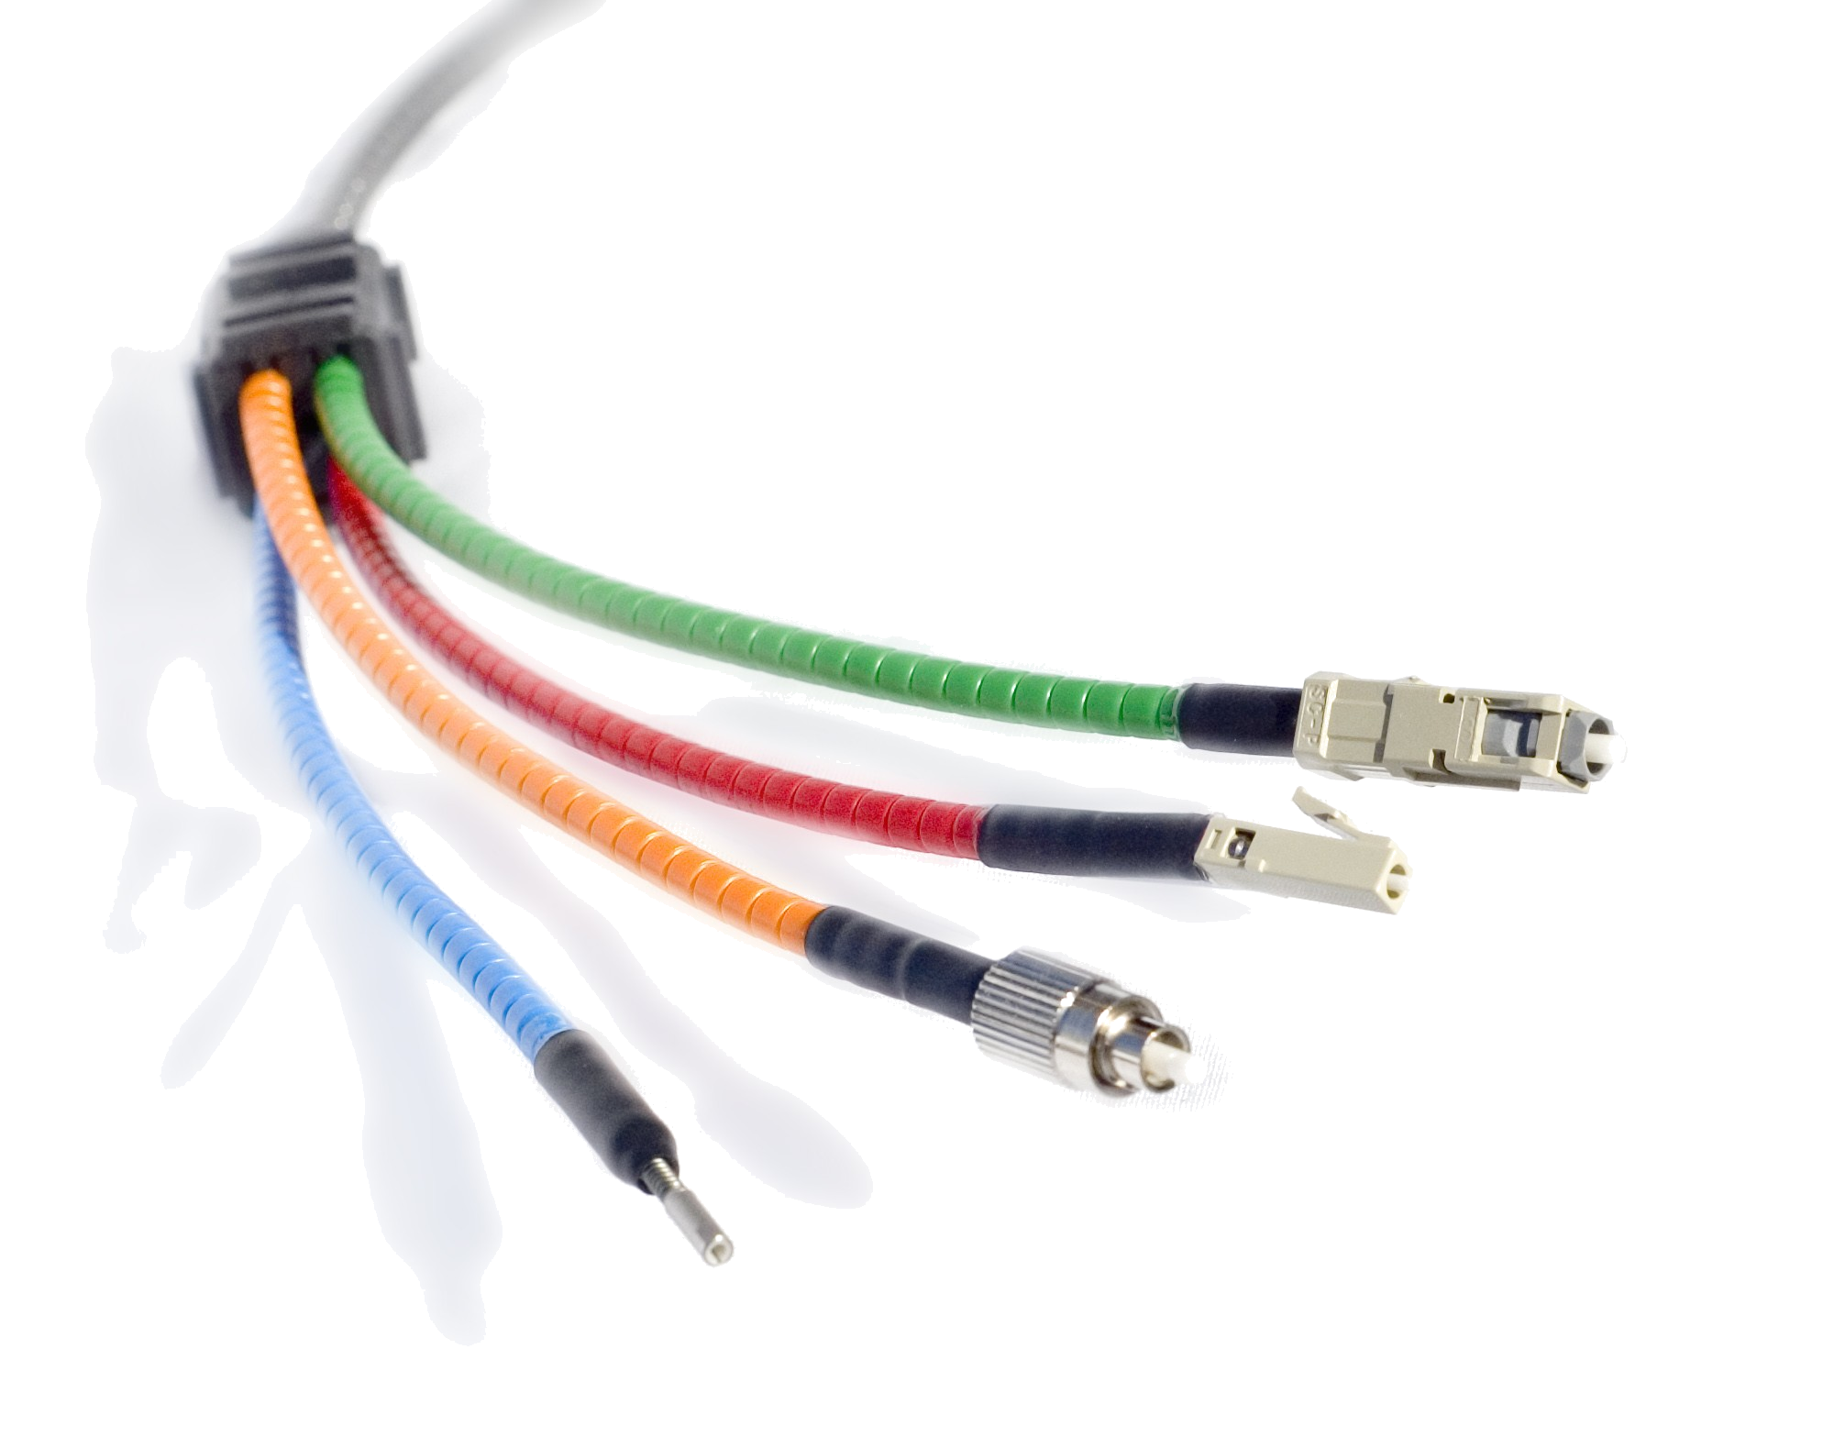

Physical Layer
From data link layer
To data link layer
110 | 10101000000010111
110 | 10101000000010111
Physical layer
Physical layer
Transmission medium
■
One of the major function of the physical layer is to move data in the form of electromagnetic signals across a transmission medium.
Its responsible for movements of individual bits from one hop (Node) to next. Both data and the signals can be either analog or digital.
Transmission media work by conducting energy along a physical path which can be wired or wireless
■
■
■
■
❑
❑
❑
❑
❑
❑
❑
Physical characteristics of interface and medium (Transmission medium)
Representation of bits (stream of bits (0s or 1s) with no interpretation and encoded into signals) Data rate (duration of a bit, which is how long it last)
Synchronization of bits (sender and receivers clock must be synchronized) Line configuration (Point-to-Point, Point-to-Multipoint)
Physical topology
Transmission mode (Simplex, half duplex, full duplex)

Slide 28
DATALINK Layer
From network layer
To network layer
Data link layer
H2
Data
T2
H2
Data
T2
Data link layer
To physical layer
From physical layer
■
Data link layer is responsible for moving frames from one hop (Node) to the next.
■
Concerned:
❑
❑
❑
❑
❑
Framing (stream of bits into manageable data units) Physical addressing (MAC Address)
Flow Control (mechanism for overwhelming the receiver) Error Control (trailer, retransmission)
Access Control (defining master device in the same link)

Slide 29
Network Layer
From transport layer
To transport layer
Network layer
H3
Data
Packet
H3
Data
Packet
Network layer
To data link layer
From data link layer
■
The network layer is responsible for the delivery of individual packets from the source host to the destination host.
■
Concerned:
❑
❑
Logical addressing (IP Address)
Routing (Source to destination transmission between networks)

Slide 30
TRANSPORT LAYER
From session layer
From session layer
Transport layer
H4 | Data |  | H4 | Data
H4 | Data
H4 | Data
H4 | Data
H4 | Data
Transport layer
Segments
Segments
To network layer
From network layer
■
The transport layer is responsible for the delivery of a message from one process to another
■
Concerned:
❑
❑
❑
❑
❑
Service-point addressing (Port address) Segmentation and reassembly (Sequence number)
Connection control (Connectionless or connection oriented) Flow control (end to end)
Error Control (Process to Process)

Slide 31


SESSION Layer
From Presentation layer
To Presentation layer
Session layer
H5
Data
Data
Data
H5
Data
Data
Data
Session layer
Syn
Syn
Syn
Syn
Syn
Syn
To transport layer
From transport layer
■
The session layer is responsible for dialog control and synchronization
■
Concerned:
❑
❑
Dialog Control (Half Duplex/Full duplex)
Synchronization (Synchronization points, process inline within same page)

Slide 32
PRESENTATION Layer
From application layer
To application layer
presentation layer
H6
Data
H6
Data
presentation layer
To session layer
From session layer
■
The presentation layer is responsible for translation, compression and encryption
■
Concerned:
❑
❑
❑
Translation (interoperability between different encoding system) Encryption (Privacy schemes)
Compression (data compression)

Slide 33
APPLICATION Layer
USER
(Human or Program)
USER
(Human or Program)
X.500
FTAM
X.400
X.500
FTAM
X.400
Application layer
Application layer
H7
Data
Message
H7
Data
Message
To presentation layer
From presentation layer
■
The application layer is responsible for providing services to the user.
■
Concerned:
❑
❑
❑
❑
Network virtual terminal (Software) File transfer, access and management Mail services
Directory services (access to distributed database sources for global information about various objects and services)

Slide 34
TRANSMISSION MEDIA

Slide 35
What is Tranmission Media ?
In data communication,
Transmission media is a pathway that carries the information from sender to receiver.
We use different types of cables or waves to transmit data.
Data is transmitted normally through electrical or
electromagnetic signals.

Slide 36
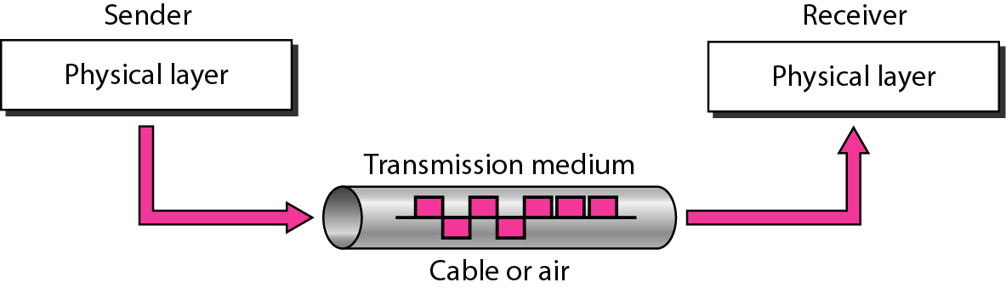
Description
Transmission media are located below the physical layer
Computers use signals to represent data.
Signals are transmitted in form of electromagnetic energy.

Slide 37
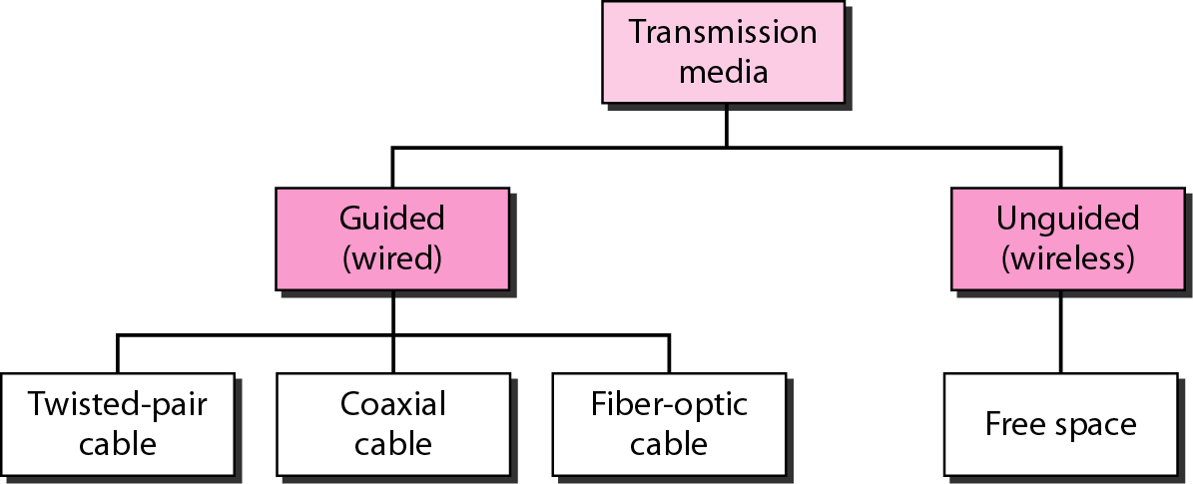
Classification of Transmission media

Slide 38
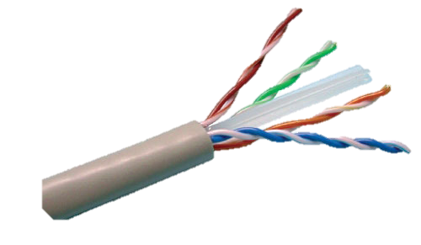
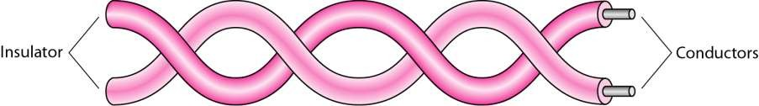
Twisted-pair cable
A twisted pair consists of two conductors
Basically copper based
With its own plastic insulation, twisted together.

Slide 39
Twisted Pair Description
One wire use to carry signals to the receiver
Second wire used as a ground reference
Very common medium
Can be use in telephone network
Connection Within the buildings
For local area networks (LAN)
Advantages:
Cheap
Easy to work with
Disadvantages:
Low data rate
Short range

Slide 40
Twisted Pair Cables
Twisted Pair cables
Unshielded Twisted Pair (UTP)
Shielded Twisted pair (STP)

Slide 41
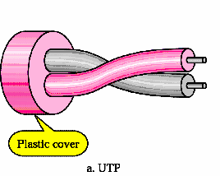
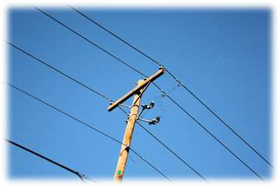
Unshielded Twisted Pair (UTP):
Pair of unshielded wires wound around each other
Easiest to install
Telephone subscribers connect to the central telephone office
DSL lines
LAN – 10Mbps or 100Mbps

Slide 42
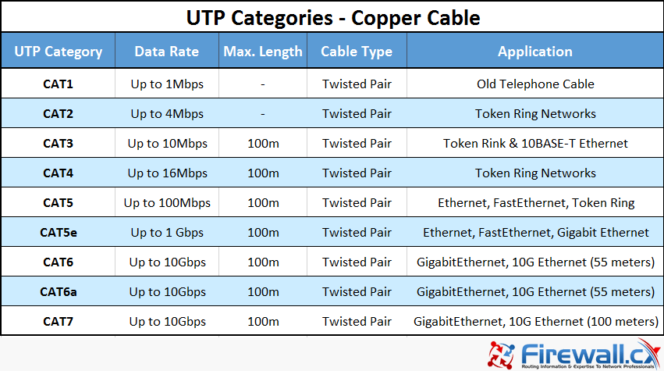
UTP Cable Types

Slide 43
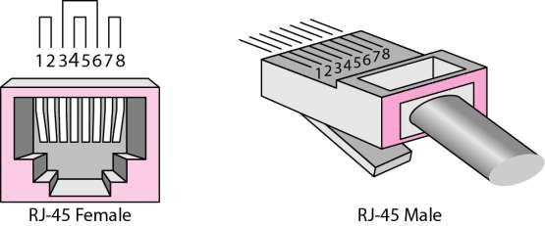
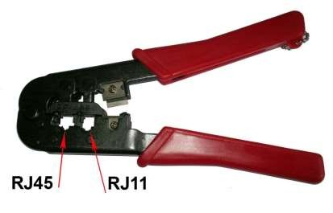
UTP connector and Tools
RJ45 (RJ stands for registered jack) is a keyed connector, it
means that it can be inserted in only one way
Crimping Tool

Slide 44
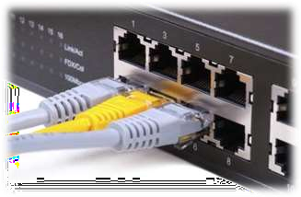
Advantages of UTP:
Affordable
Most compatible cabling
Major networking system
Disadvantages of UTP:
Suffers from external Electromagnetic interference

Slide 45
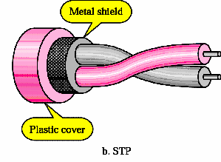
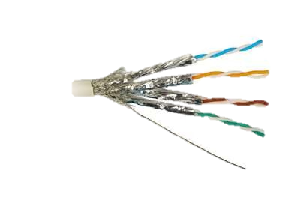
Shielded Twisted Pair (STP)
Pair of wires wound around each other placed inside a protective foil wrap
Metal braid or sheath foil that reduces interference
Harder to handle (thick, heavy)
STP is used in IBM token ring networks.
Higher transmission rates over longer distances.

Slide 46
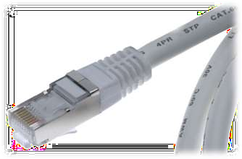
Advantages of STP:
Shielded
Faster than UTP
Disadvantages of STP:
More expensive than UTP
High attenuation rate

Slide 47
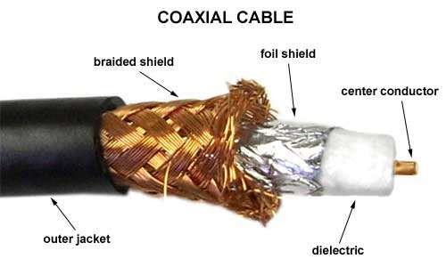
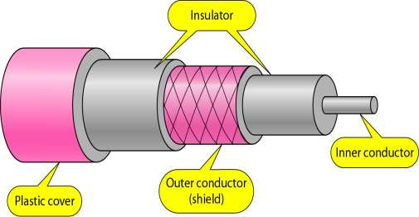
Co-axial Cable
Co-axial cable carries signal of higher frequency ranges than twisted pair cable
Inner conductor is a solid wire
Outer conductor serves as a shield against noise and a second conductor

Slide 48
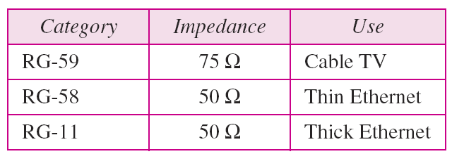
Categories of coaxial cables
Coaxial cables are categorized by Radio Government (RG) ratings, RG is De Jure standards

Slide 49
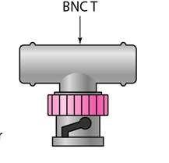
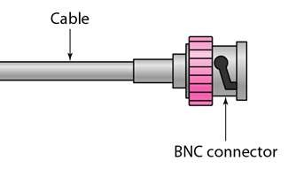
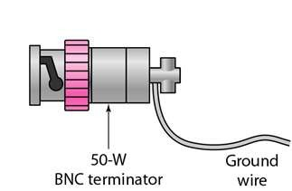
Coaxial Cable Connectors
BNC Connectors – Bayone Neil Concelman
To connect coaxial cable to devices we need coaxial connectors
BNC Connector is used at the end of the cable to a device
Example: TV set conenction
BNC T connector used to Ethernet networks to branch out connection to computer or other devices
BNC terminator is used at the end of the cable to prevent the reflection of the signal

Slide 50
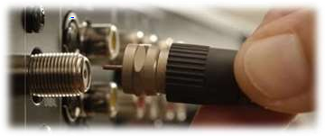
Coaxial Cable Applications
Most versatile medium
Television distribution
Long distance telephone transmission
Can carry 10,000 voice calls simultaneously
Short distance computer systems links
Local area networks
ADVANTAGES
Easy to wire
Easy to expand
DISADVANTAGE
Single cable failure can take down an entire network

Slide 51

Fiber-Optic Cable
A fiber optic cable is made of glass or plastic and transmit signals in the form of light.
Nature of light:
Light travels in a straight line
If light goes from one substance to another then the ray of light changes direction
Ray of light changes direction when goes from more dense to a less dence substance

Slide 52
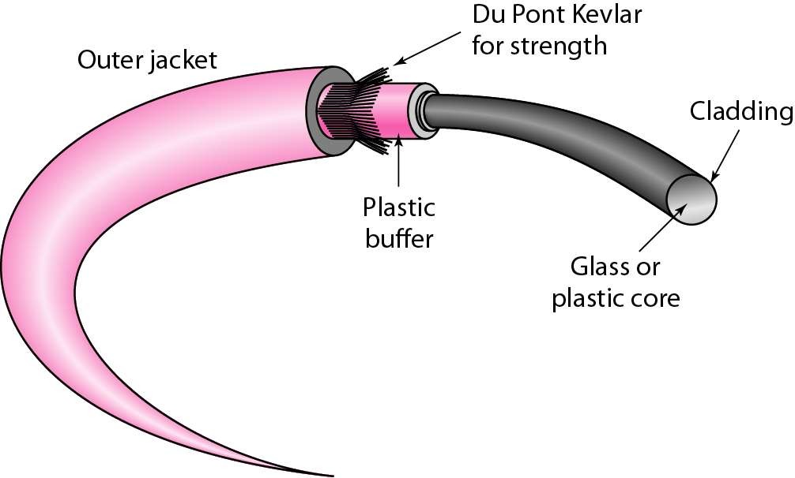
Fiber Construction

Slide 53
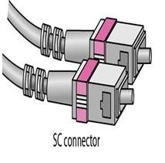
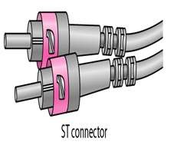
Fiber – Optic cable Connectors
Subscriber Channel (SC) Connecter
Straight-Tip (ST) Connecter

Slide 54
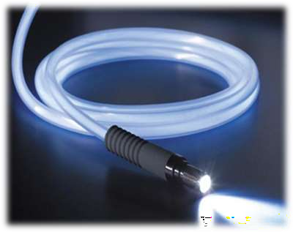
Areas of Application
Telecommunications
Local Area Networks
Cable TV
CCTV
Advantage
Greater capacity Example: Data rates at 100 Gbps
Smaller size & light weight
Lower attenuation
Disadvantage
Installation and maintenance are
Expensive
Only Unidirectional light propagation

Slide 55
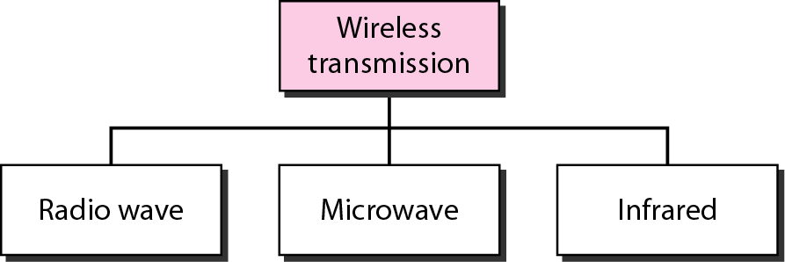
Unguided Media
Wireless transmission waves

Slide 56
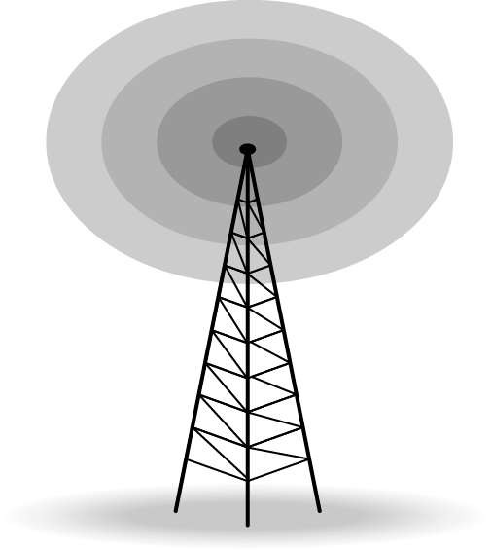
Unguided Media – Radio Waves
Omnidirectional Antenna
Frequencies between 3 KHz and 1 GHz.
Used for multicasts(multiple way) communications, such as radio and television, and paging system.
Radio waves can penetrate buildings easily, so that widely use for indoors & outdoors communication.

Slide 57
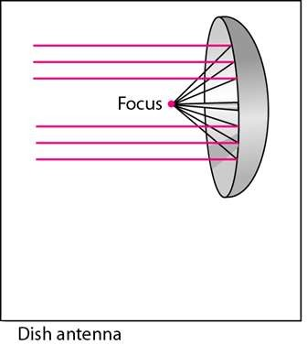
Antennas
An Antenna is a structure that is generally a metallic object may be a wire or group of wires, used to convert high frequency current into electromagnetic waves.
Antenna are two types:
Transmission antenna
Transmit radio frequency from transmitter
Radio frequency then
Convert to electromagnetic energy by antenna
Then, radiate into surrounding environment

Slide 58
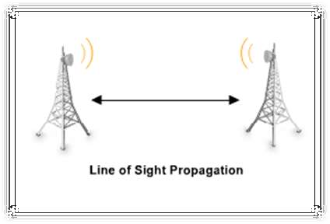
Microwaves
Microwaves are ideal when large areas need to be covered and there are no obstacles in the path

Slide 59

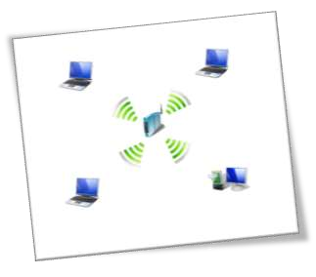
Micro waves Transmission
Microwaves are unidirectional
Micro waves electromagnetic waves having frequency between 1 GHZ and 300 GHZ.
There are two types of micro waves data communication system
: terrestrial and satellite
Micro waves are widely used for one to one communication between sender and receiver,
example: cellular phone, satellite networks and in wireless LANs(wifi), WiMAX,GPS

Slide 60
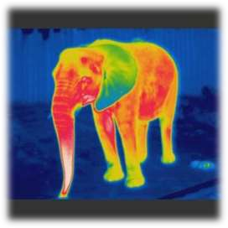



Infrared
Frequencies between 300 GHz to 400 THz.
Used for short-range communication
Example: Night Vision Camera,Remote control, File sharing between two phones, Communication between a PC and peripheral device

Slide 61

What is PING?
It stands for Packet Internet Gropher The ping command is usually used as a simple way to verify that a computer can communicate over the network with another computer or network device. The ping command operates by sending Internet Control Message Protocol (ICMP) Echo Request messages to the destination computer and waiting for a response.

Slide 62
NETWORKING DEVICES
1

Slide 63

Introduction
To connect LANs, connecting devices are needed and various connecting devices are such as bridge, switch, router, hub, repeater.
Types of Networking Devices :-
NIC Card
Repeater
Hub
Bridge
Switch
Gateway
Router
Modem

Slide 64

CONNECTING DEVICES
Connecting devices into five different categories based on the layer in which they operate in a network.

Slide 65

NIC or Network Card
It stands for Network Interface Controller. NIC used to connect the ethernet cable (RJ-45), (SC,ST Connector) with the PC. It is a Card which have Mac Address written on it.
Components of NIC :-
Metal Expansion Card
Boot ROM Chip
32 bit PCI Controller
Activity LED
RJ-45 LAN Port

Slide 66

A NIC connecting a LAN

Slide 67


Repeaters
Repeater used to regenerate or replicate a signal. It removes the unwanted noise in an incoming signal, it works on Layer 1 of OSI Model
It is used in some scaled area and it refine the signals and manage the proper speed of the network

Slide 68

Repeater connecting two segments of a LAN

Slide 69

HUB
It is a Networking Device which simply receive data from one port and transfer on all the other ports. HUBs are commonly used to connect segments of LAN. Hub Works on Physical layer of OSI Moodel
It used in where you have to create multiple ethernet with the help of a nnetworking device. It comes with different port segment like 6,12 & 24

Slide 70

A HUB connecting LAN

Slide 71


Bridge
Bridge Devices inspect incoming network traffic and determine whether to forward or discard it according to its intended destination it operates on data link layer
A bridge is a type of computer network device that provides interconnection with other bridge networks that use the same protocol.

Slide 72

A bridge connecting two LANs
A bridge does not change the physical (MAC) addresses in a frame.

Slide 73

Function of Bridge

Slide 74


Switch
A Switch can recieve input or signal from any of one port and transmit it on all the ports. Ethernet LAN is used to connect to a switch that correct system. It works on Data link layer of OSI Model
It is a small device that transfers data packets between multiple network devices such as computers, routers, servers or other switches

Slide 75

A switch connecting a LAN

Slide 76


Gateway
Gateway Connects two networks together with the help of gateway devices like firewire & router. It is a node between the public network and private network which makes some security with the help of identification
A gateway is a networking device that connects two networks using different protocols together. it also acts as a “gate” between two networks.

Slide 77

A Gateway connecting a LAN

Slide 78


Router
Router is a networking device which is used to provide interaction between two different networks. Router are also used for provide the routes to the data and devices that are connected in network. Router are used to establish internetwork communication
A router inspects a given data packet's destination Internet Protocol address (IP address), and provide connection to the nodes with the main network. It gives you wired and wireless both connectivities.

Slide 79

A Router connecting a LAN

Slide 80


MODEM
”Modulator-Demodulator” A modem or broadband modem is a hardware device that connects a computer or router to a broadband network. It converts or "modulates" an analog signal from a telephone or cable wire to digital data (1s and 0s) that a computer can recognize.
The main difference between the two devices is that a modem lets you connect to the internet, while a router distributes that connection to different devices. A modem is your gateway to the web, while a router is a central hub for your devices.

Slide 81

A Modem connecting a LAN

Slide 82
NETWORK TOPOLOGIES
1

Slide 83
Topology
Topology refers to the layout of connected devices on a network.
Here, some logical layout of topology.
Mesh
Star
Ring
Line
Bus
Tree
Hybrid

Slide 84

Network Topology

Slide 85
Mesh Topology
Here every device has a point to point link to every other device.
Advantages:
They use dedicated links so each link can only carry its own data load. So traffic problem can be avoided.
It is robust. If any one link get damaged it cannot affect others.
It gives privacy and security.
Fault identification and fault isolation are easy.

Slide 86


Mesh Topology

Slide 87
Star Topology
Here each device has a dedicated point-to-point link to the central controller called “Hub”(Act as a Exchange).
There is no direct traffic between devices.
The transmission are occurred only through the central “hub”.
When device 1 wants to send data to device 2; First sends the data to hub. Which then relays the data to the other connected device.

Slide 88


Star Topology

Slide 89
Bus Topology
A bus topology is multipoint.
Here one long cable act as a backbone to link all the devices are connected to the backbone by drop lines and taps.
Drop line- is the connection b/w the devices and the cable.
Tap- is the splitter that cut the main link.
This allows only one device to transmit at a time.

Slide 90


Bus Topology

Slide 91

Bus Topology

Slide 92
Ring Topology
Here each device has a dedicated connection with two devices on either side.
The signal is passed in one direction from device to device until it reaches the destination and each device have repeater.
When one device received signals instead of intended another device, its repeater then regenerates the data and passes them along.
To add or delete a device requires changing only two connections.

Slide 93


Ring Topology

Slide 94
Tree Topology
Alternatively referred to as a star bus topology.
Tree topology is one of the most common network setups that is similar to a bus topology and a star topology.
A tree topology connects multiple star networks to other star networks. Below is a visual example of a simple computer setup on a network using the star topology.

Slide 95

Tree Topology

Slide 96

Hybrid Topology
A network which contain all type of physical structure and connected under a single backbone channel.

Slide 97
Considerations for choosing topology
Money-Bus n/w may be the least expensive way to install a n/w.
Length-of cable needed- the linear bus n/w uses shorter lengths of cable.
Future growth-with star topology, expending is easily done by adding another
Cable type-most common used cable in commercial organization is twisted pair. Which often used with star topologies.

Slide 98
IP Addressing IPv4
An IP address basically a 32-bit address that uniquely universally defines connection of host or a router to the Internet. IP address is unique.
Introduced by IANA (Internet Assigned Numbers Authority).
32 bit is divided into 4 equal parts of 8-8 bits separated by dotted decimal notation. It is in the range of minimum 0.0.0.0 to 255.255.255.255.
Each 8 bit group is known by OCTET.

Slide 99
Various IP classes
IP has five different classes differentiated by characteristics.
Class-A ranges from 0 to 127
Class-B ranges from 128 to 191
Class-C ranges from 192 to 223
Class-D ranges from 224 to 239
Class-E ranges from 240 to 255
First Octet is defines the class of particular IP e.g. - 128.11.3.31 is follow in class –B
127.0.0.0 to 127.255.255.255 is a range of look back IP.

Slide 100

Classes of IP addresses
Class-A
This IP ranges from 0 to 126 Decimal value in first octet. And 1st octet defines network part and remaining three octet defines the Host part. It patterns like this NHHH (N-Network; H- Host).
First 8bits defines network and remaining 24 bits defines host parts. It has a highest nos. of address 2³¹.which is about 16,277,216.
Lie between 10.1.1.1 to 126.255.255.255

Slide 101
Class B
This IP ranges from 128 to 191 Decimal value in first octet. And 1st two bit defines network part and remaining two octet defines the Host part. It patterns like this NNHH (N-Network; H-Host).
First 16 bits defines network and remaining 16 bits defines host parts. It has a highest nos. of address 2³⁰.which is about 65,536.
IP ranges from 128.16.0.0 to 172.31.255.255.

Slide 102
Class C
This IP ranges from 192 to 223 Decimal value in first octet. And 1st three bit defines network part and remaining one octet defines the Host part. It patterns like this NNNH (N-Network; H-Host).
First 24 bits defines network and remaining 8 bits defines host parts. It has a highest nos. of address 2²⁹.which is about 53,68,70,912
IP ranges from 192.168.0.0 to 223.255.255.0.

Slide 103
Class-D
This IP ranges from 224 to 239 Decimal value in first octet.
It is not usually use in general applications.
It is use in Special purpose applications known as Multicast.

Slide 104
Class-E
This IP ranges from 240 to 255 Decimal value in first octet. It is not usually use in general applications.
It is reserved range of IP by R & D (Research and Development) department. Usually, Class-A to C is supported by PC and Class-D and E is not supported.

Slide 105
IP Addressing IPv6
An IP address basically a 128-bit address that uniquely universally defines connection of host or a router to the Internet. IP address is unique.
Introduced by IANA (Internet Assigned Numbers Authority).
total of 4,294,967,296 unique IP addresses can be assigned to hosts.
IP is like 2001:db8:1234::f350:2256:f3dd/64
It supports Unicast. Telecast & Multicast.
It doesn’t have Classes like ipv4

Slide 106

What Is Subnet Mask?
A subnet mask is a 32- or 128-bit number that segments an existing IP address in a TCP/IP network. It is used by the TCP/IP protocol to determine whether a host is on the local subnet or on a remote network. Subnet mask divides the IP address into a network address and host address, hence to identify which part of IP address is reserved for the network and which part is available for host use.

Slide 107


Slide 108

What Is DHCP?
A DHCP Server is a network server that automatically provides and assigns IP addresses, default gateways and other network parameters to client devices. It relies on the standard protocol known as Dynamic Host Configuration Protocol or DHCP to respond to broadcast queries by clients. Its alternate is APIPA

Slide 109

What Is DNS?
Domain Name Servers (DNS) are the Internet's equivalent of a phone book. They maintain a directory of domain names and translate them to Internet Protocol (IP) addresses. This is necessary because, although domain names are easy for people to remember, computers or machines, access websites based on IP addresses.

Slide 110

What Is MAC Address?
A media access control address is a unique identifier assigned to a network interface controller for use as a network address in communications within a network segment. This use is common in most IEEE 802 networking technologies, including Ethernet, Wi-Fi, and Bluetooth.

Slide 111
TCP/IP model
The TCP/IP model was developed prior to the OSI model.
The TCP/IP model is not exactly similar to the OSI model.
The TCP/IP model consists of five layers: the application layer, transport layer, network layer, data link layer and physical layer.
The first four layers provide physical standards, network interface, internetworking, and transport functions that correspond to the first four layers of the OSI model and these four layers are represented in TCP/IP model by a single layer called the application layer.
TCP/IP is a hierarchical protocol made up of interactive modules, and each of them provides specific functionality.

Slide 112


Model

Slide 113




Ethernet Cable
Also known as RJ-45 cable
Connect one end to: router, network switch
Connect other end to: Ethernet port on computer (see image below)

Slide 114


Ethernet Port
Connects to a network and high speed Internet.
Connects the network cable to a computer.
This port resides on an Ethernet Card.
Data travels at 10 megabits to 1000 megabits per seconds depending upon the network bandwidth.

Slide 115



What are RJ connectors?
RJ Connectors are a family of push-and-click connectors for twisted-pair wiring in telephone and network wiring. RJ stands for Registered Jack. RJ types define both a jack or receptacle (female) and a plug (male) type of connector.
The most common types of RJ connectors are as follows:
RJ-11 connector: A 4-wire or 6-wire telephone-type connector
RJ-45 connector: An 8-wire telephone-type connector
RJ-48 connector: An 8-wire telephone-type connector TP

Slide 116


Slide 117

What is BNC connector?
Bayonet Neill–Concelman BNC connector is a series of connectors used for connecting thinnet coaxial cabling to various networking components. BNC connectors use a twist-and-lock mechanism that provides a secure connection between network cabling and components.
BNC connectors are typically used on 10Base2 Ethernet networks. The different types of BNC connectors include the following:
BNC cable connector
BNC T-connector
BNC barrel connector
BNC terminator

Slide 118


Slide 119



What is SC and ST connectors?
Connector types that are generally used for connecting fiber-optic cabling to networking devices. Both are recognized by the Electronic Industries Alliance/Telecommunications Industry Association (EIA/TIA) 568A standard.
Subscriber Connector SC
This Connector is for structural cabling it is used for high speed
And for single mode fibre cabling
Straight Tip ST
This Connector is for structural cabling it is used for high speed
And for Multi mode fibre cabling
Lucent Connector LC
LC connectors can be used with both single-mode and multi-mode cables.

Slide 120


Slide 121
What is SC and ST connectors?
Connector types that are generally used for connecting fiber-optic cabling to networking devices. Both are recognized by the Electronic Industries Alliance/Telecommunications Industry Association (EIA/TIA) 568A standard.
Subscriber Connector SC
This Connector is for structural cabling it is used for high speed
And for single mode fibre cabling
Straight Tip ST
This Connector is for structural cabling it is used for high speed
And for Multi mode fibre cabling
Lucent Connector LC
LC connectors can be used with both single-mode and multi-mode cables.

Slide 122


Slide 123
Wireless Networking

Slide 124


Wi-Fi & Bluetooth

Slide 125


Wi-Fi
◆ What is Wi-Fi
◆ Short for “Wireless Fidelity”
◆ A trademark of the Wi-Fi Alliance
◆ The brand name for products using the IEEE 802.11 family of standards
◆ Commonly used for “wireless local area network” (WLAN)

Slide 126


Bluetooth
◆ Wireless Personal Area Networks (WPAN)
◆ Design goal
◆ Cable replacement
◆ Low cost
◆ Low power
◆ Small size
◆ For mobile devices
◆ Standard: IEEE 802.15.1

Slide 127

Wi-fi Standards

Slide 128

Bluetooth Evolution

Slide 129









Wi-Fi vs. Bluetooth
 | Bluetooth | Wifi
Specifications authority | Bluetooth SIG | IEEE, WECA
Year of development | 1994 | 1991
Bandwidth | Low ( 800 Kbps ) | High (11 Mbps )
Hardware requirement | Bluetooth adaptor on all the devices connecting with each other | Wireless adaptors on all the devices of the network, a wireless router and/or access points
Cost | Low | High
Power Consumption | Low | High
Frequency | 2.4 GHz | 2.4 GHz
Security | It is less secure | It is more secure
Range | 10 meters | 100 meters
Primary Devices | Mobile phones, mouse, keyboards,office and industrial automation devices | Notebook computers, deskto computers, servers
Ease of Use | Fairly simple to use. Can be used to connect up to seven devices at a time. It is easy to switch between devices or find and connect to any device. | It is more complex and requires configuration of hardware and software.
Vs.

Slide 130


Wi-Fi CARD
Internal
External
Internal
External

Slide 131


Bluetooth CARD
Internal
External
Internal
External

Slide 132
Network Threads

Slide 133
Types of Viruses
Macro Virus
Executable Virus
Backdoor Virus

Slide 134
Macro Viruses
Most common type of virus on campus Affect Microsoft Office documents Written in Visual Basic for Applications
Generally harmless with a few destructive varients
Executable Viruses
Second most common type of virus on campus
Written in programming languages and compiled into executable files
Backdoor Programs
Allow anyone on the internet to remotely control the infected computer
Send and receive files
View the screen
Monitor all keystrokes

Slide 135


Slide 136
Firewall
A firewall is a network security device, either hardware or software-based, which monitors all incoming and outgoing traffic and based on a defined set of security rules it accepts, rejects or drops that specific traffic.
Accept : allow the traffic Reject : block the traffic but reply with an “unreachable error” Drop : block the traffic with no reply
A firewall establishes a barrier between secured internal networks and outside untrusted network, such as the Internet.

Slide 137


Slide 138

Proxy Server
A proxy server is a server that acts as an intermediary for requests from clients seeking resources from other servers. Today, most proxies are web proxies that facilitate access to content on the internet, while providing anonymity.

Slide 139
TROUBLESHOOTING

Slide 140
#1 Pinging Problem
Step-1 :- Check Discovery
Step-2 :- Check Firewall
Step-3 :- Check IP Address
Step-4 :- Check Host and Medium
#2 No Printing
Step-1 :- Goto services.msc
Step-2 :- Check Printer Spooler Service
Step-3 :- Restart it
Step-4 :- Now give Printing Command

Slide 141
#3 No Internet Access
Step-1 :- Check Adapters and Ports
Step-2 :- Check Physical Connectivity like wires, router & switch
Step-3 :- Restart your Network devices and System
Step-4 :- Try to Check Default in Cable Line
#4 IP Conflict
Step-1 :- Check with Ping in another Device after Shutdown
Step-2 :- If it is Pinging Change your IP
Step-3 :- Goto ncpa.cpl and select adapter and ipv4 or ipv6
Step-4 :- Now give a new Unique Supported Static IP

Slide 142
Abbrevations
E-mail - Electronic Mail
HTML - Hyper Text Markup Language
STP - Shielded Twisted pair
UTP - Unshielded Twisted pair
URL - Uniform Resource Locator
WWW - World Wide Web
ISP - Internet Service Provider
HTTP - Hyper Text Transfer Protocol
PPP - Point to Point Protocol
TCP - Transmission Control Protocol
NTP - Network Time Protocol
SMTP - Simple Mail Transfer Protocol
POP - Post Office Protocol
IMAP - Internet Mail Access Protocol
LAN - Local Area Network
MAN - Metropolitan Area Network
WAN - Wide Area Network
PAN - Personal Area Network
NIU - Network Interface Unit
NIC - Network Interface Card
MAC - Media Access Control
TCP - Transmission Control Protocol
IP - Internet Protocol
Bps - Bits Per Second
gbps - Gigabyte Per Second
KHz - kilohertz

Slide 143
NFS - Network File System
RJ-45 - Registered Jack-45
CD - Carrier Detect
CTS - Clear – to-Send
DTE - Data Terminal Equipment
DCE - Data Communication Equipment
DTR - Data Terminal Ready
FAT - File Allocation Table
DNS - Domain Name System
PING - Packet InterNet Groper
W3C - World Wide Web Consortium
ARP - Address Reolution Protocol
RARP - Rev. Address Reolution Prot.
Telnet - Terminal Network
VoIP - Voice over Internet Protocol
SIP - Session Initiation Protocol
Wi-Fi - Wireless Fidelity
GSM - Global system for mobile comm
GPRS - General Packet Radio Service
CDMA - Code Division Multiple Access
WLL - Wireless in Local Loop
3G - Third Generation
IRC - Internet Relay Chat
SMS - Short Message Service
TDMA - Time Division Multiple Access
UMTS - Universal Mobile Telephone System

Slide 144
RUN Commands
Ncpa.cpl - For Network Adapters
Firewall.cpl - For Windows Firewall Settings
Services.cpl - For Getting Windows Sercices
Devmgmt.msc - For Device Management Settings
Mstsc - For Remote Desktop Connection
Msra - For Windows Remote Assistance
gpedit.msc - For Windows Policies Settings

